Slide 1
Brentney Simon
An inspirational story

Slide 2
Overview
About Brentney Simon
Her condition
What made her story inspiring?
How is it related to commitment, and how it made us feel?

Slide 3
Brentney Simon
A brief summary of her life

Slide 4
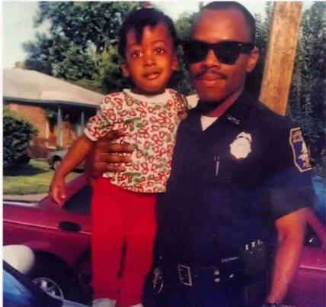
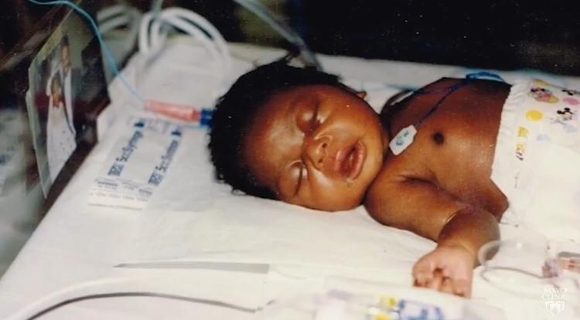
Born on 1993
With some abnormalities
Genetic neurology and other tests

Slide 5
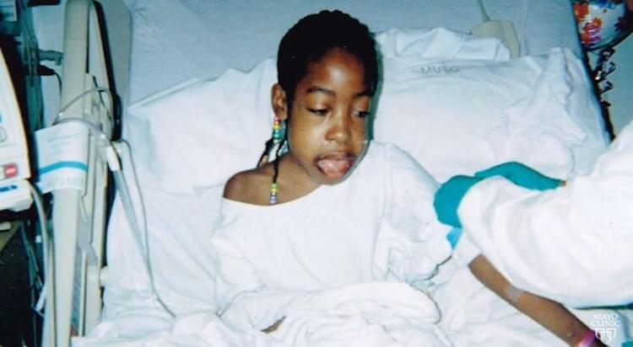
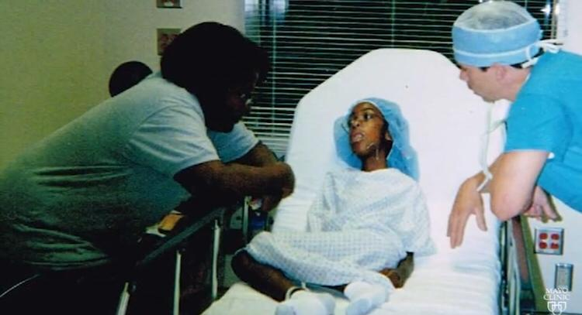
Collapsed lungs
Heart problems
Stayed in ICU
Pneumonia, double pneumonia

Slide 6
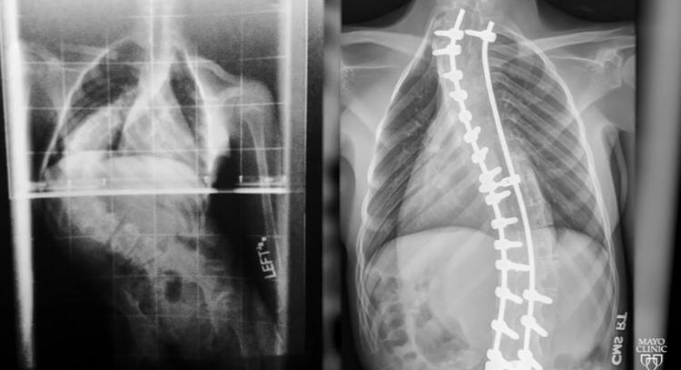
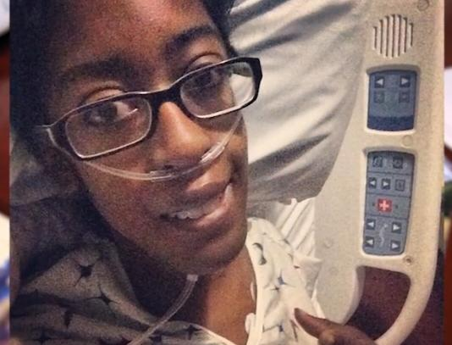
Curved spine
Stereo diagnosis
Came up with about 100 disorders
Joined college
After 1st semester she was very ill

Slide 7
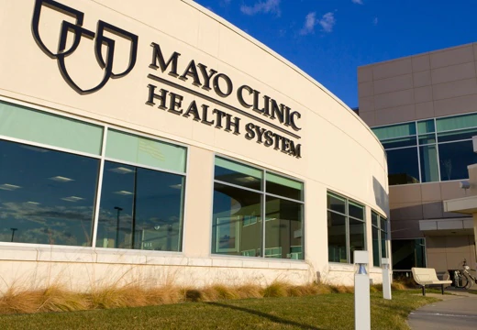
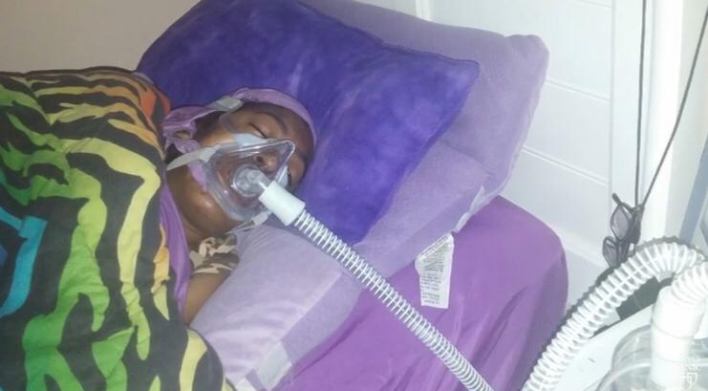
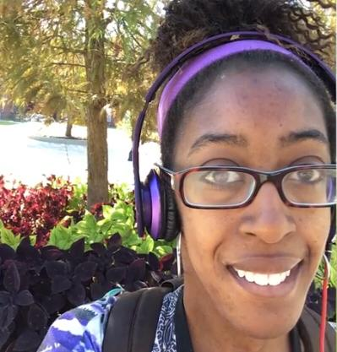
Mayo Clinic
Machine she was on was working against her
New machine helped her just after 2 nights

Slide 8
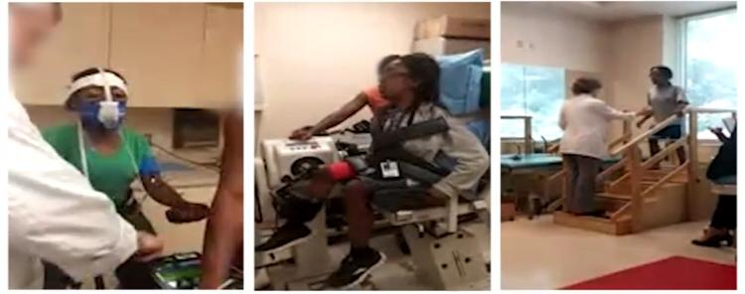
Ryr1 myopathy disease
Rare disease
No treatment or cure
Participating in a clinical trial

Slide 9
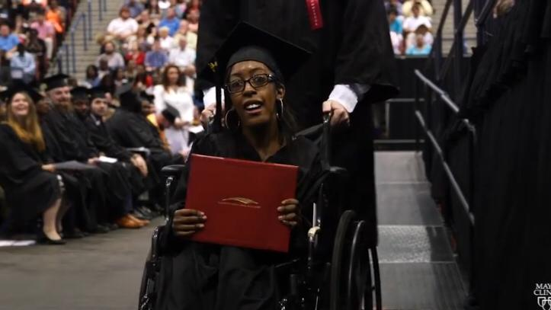
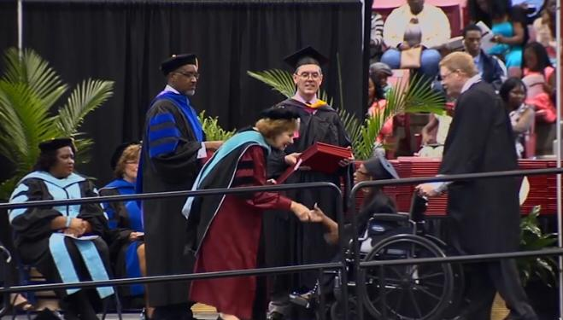
Achieved associates degree

Slide 10
Her condition
RYR1 myopathy

Slide 11
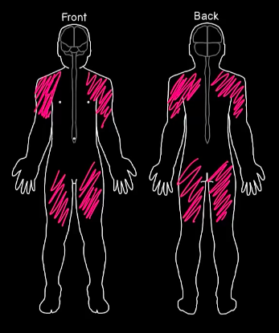
MYOPATHY
Diffuse Dysfunctional of Skeletal Muscle
Muscle fibres do not function properly
Muscular weakness

Slide 12
What is RYR-1?
Ryanodine receptor 1
Also known as ‘skeletal muscle calcium release channel’
A protein in skeletal muscle
form channels that transport calcium ions within cells
Crucial for muscles used for movements (skeletal muscles)

Slide 13
RYR1 related disease (RYR1 Myopathy)
caused by mutations in the RYR-1 gene
Symptoms include: scoliosis, facial weakness, eye muscle weakness, muscle cramps
RYR-1 gene provides instructions for production of the RYR-1 receptor
abnormal RYR-1 receptors lead to dysfunctional muscle contraction

Slide 14
Inspirational Story

Slide 15
She taught me: you don’t complain, you do the best you can and you keep on going

Slide 16
She’s never been one to let anything stop her

Slide 17
Her Commitment

Slide 18
An example of her having commitment
Even though she had to visit and even stay in the hospital multiple times, she still did her college work, studying and writing papers
Resulting in her graduating with a degree

Slide 19
Conclusion
How this story made us feel

Slide 20
After learning about Brentney’s story
We shouldn’t take life for granted
Appreciate and treasure our lives
Anything is possible

