Slide 1
Video of honesty of Japanese Children
Speaking and acting in accordance with the truth
Keeping every promise we make

Slide 4
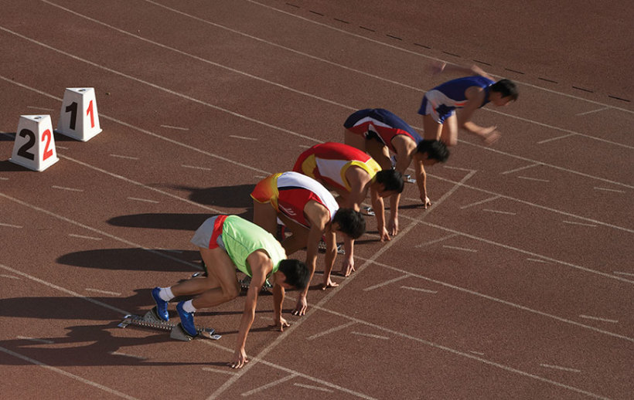

Slide 12
Thank you

