Slide 1
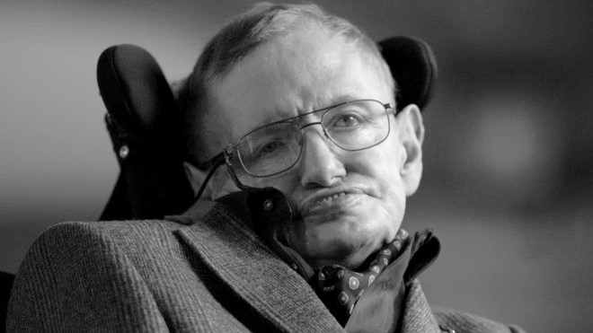
STEPHEN HAWKING
(1942-2018)
by Ifra 6B, Naheyan 6C, Kamran 6B

Slide 2
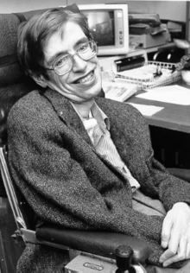
background info:
born in Oxford, England in 1942
an english theoretical physicist, cosmologist and an author
science books (best-sellers)
has received Presidential medal of freedom

Slide 3
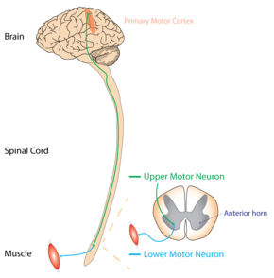
ALS (Lou Gehrig’s Disease)
also known as motor neurone disease (MND)
both the upper motor neurons and the lower motor neurons degenerate or die, and stop sending messages to the muscles.
weakness in the arms or legs, or with difficulty speaking or swallowing
most eventually lose the ability to walk, use their hands, speak, swallow, and breathe.
believed to involve both genetic and environmental factors

Slide 4
The Theory of Everything
shows major events in Hawking’s life
the difficulties he and his family went through
what kept him motivated and inspired to continue on in his study of time
Hawking is played by Eddie Redmayne and Jane Wilde is played by Felicity Jones

Slide 5
how is he related to the topic “commitment”?

Slide 6
thank you :)

